Slide 1
Introduction to Cloud Computing and AWS

Slide 2
Agenda
What is Cloud Computing?
AWS fundamental

Slide 3
1. Identity and Access Management
Subtitle

Slide 4
What is IAM?
With IAM, you define who can access what by specifying fine-grained permissions. IAM then enforces those permissions for every request. Access is denied by default and access is granted only when permissions specify an "Allow."
Global service

Slide 5
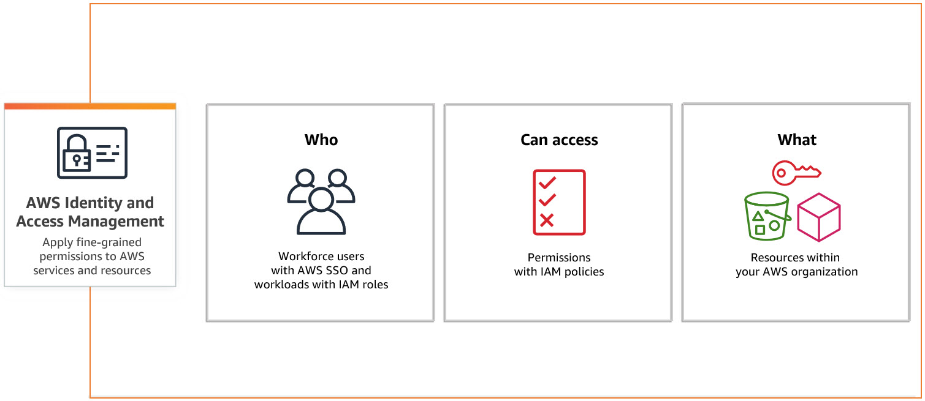
What is AWS IAM?

Slide 6
IAM Identities
AWS account root user
IAM user
IAM group
IAM role
IAM policies

Slide 7
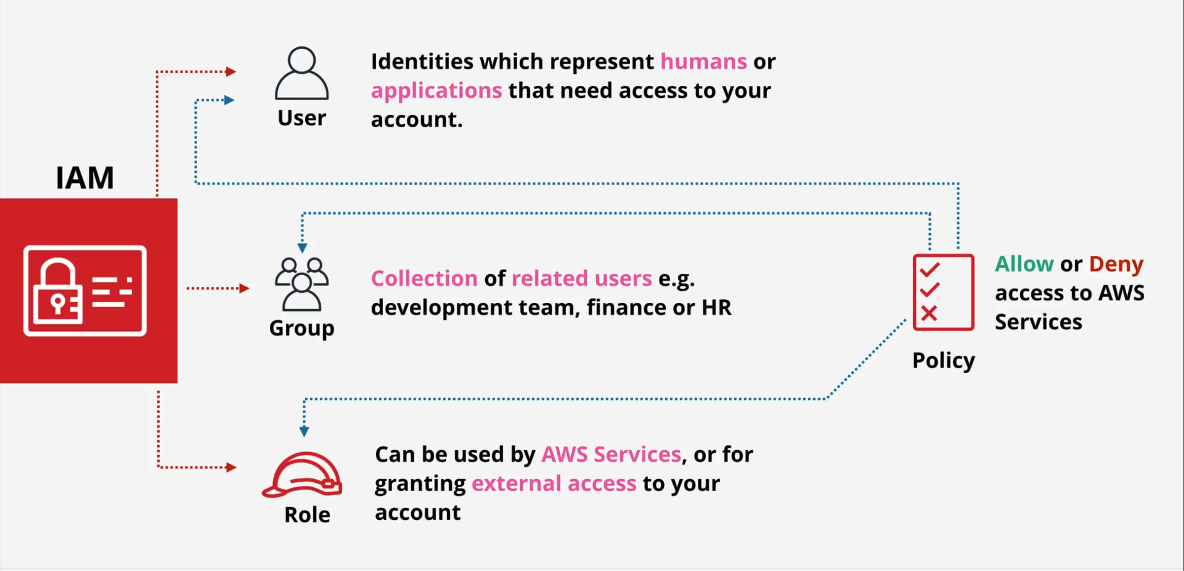
IAM Identities
Notes:
User can belong to multiple groups. User don’t have to belong to a group

Slide 8
IAM policies
Consist of
Version: policy language version, always include “2012-10-17”
Id: optional
Statement: one or more individual statement (required)
Sid: optional
Effect: whether the statement allows or denies access (allow/deny)
Principal: account/user/role to which this policy applied to
Action: list of action this policy allows or denies
Resource: list of resource wot which the actions applied to
Condition: conditions for when this policy is in effect (optional)
Notes:
User can belong to multiple groups. User don’t have to belong to a group

Slide 9
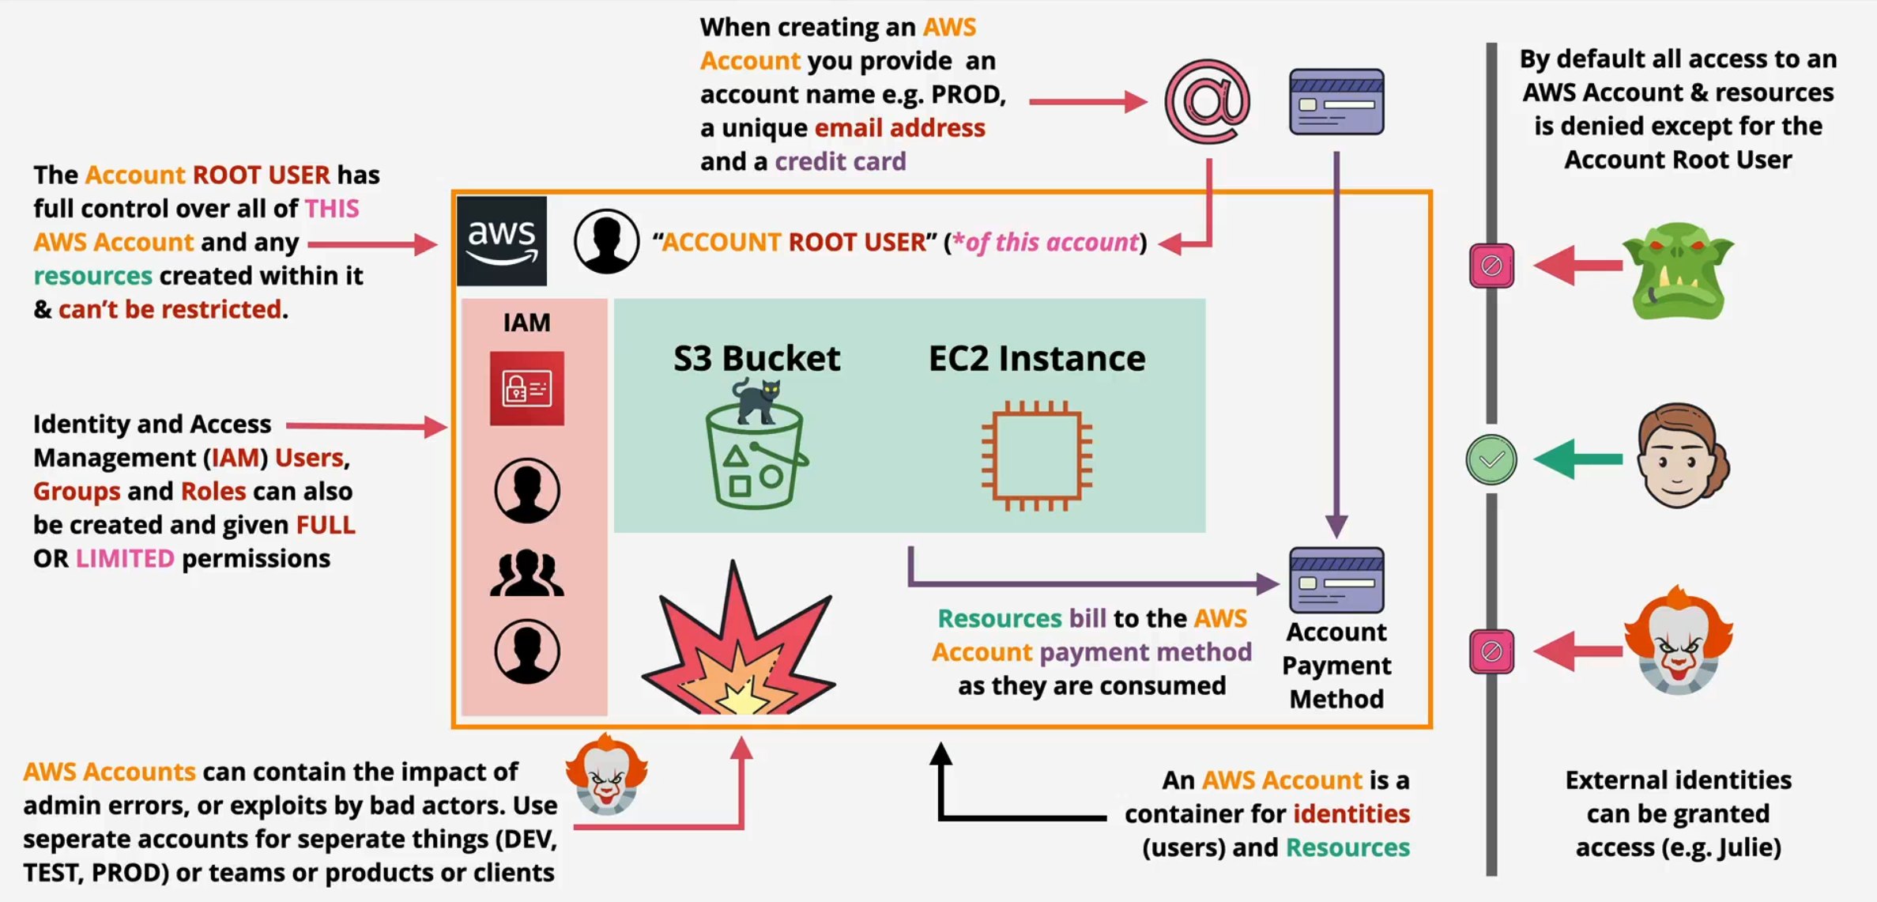
AWS account root user

Slide 10
When to use an IAM user
Workloads that cannot use IAM roles (such as for WordPress plugins)
Third-party AWS clients (tools that don’t support access with IAM Identity Center)
AWS CodeCommit, Amazon Keyspaces access
Emergency access

Slide 11
When to use an IAM role
You're creating an application that runs on EC2 instance and that application makes requests to AWS.
You're creating an app that runs on a mobile phone and that makes requests to AWS.
Users in your company are authenticated in your corporate network and want to be able to use AWS without having to sign in again—that is, you want to allow users to federate into AWS.

Slide 12
Hands-on
Enable MFA
Create user and add this user to admin group with Administrator access
Create user and add inline policies (ex: IAMReadOnlyAccess)
Setup AWS CLI

Slide 13
EC2 Basic

Slide 14
What is EC2
Infrastructure as a Service – Provides virtual machines => Instances
Private service by default – using VPC networking
AZ resilience
Running on EC2 Host: shared hosts or dedicated hosts

Slide 15
EC2 ecosystem
Renting virtual machines (EC2)
Storing data on virtual drives (EBS)
Distributing load across machines (ELB)
Scaling the services using an auto-scaling group (ASG)

Slide 16
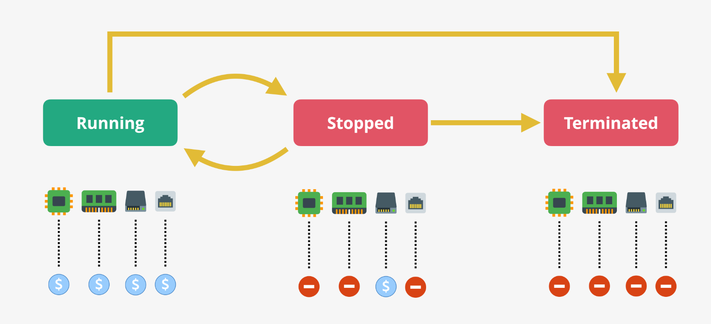
EC2 lifecycle

Slide 17
EC2 configuration options
Operating System (OS): Linux, Windows or Mac OS
How much compute power & cores (CPU)
How much random-access memory (RAM)
How much storage space:
Network card: speed of the card, Public IP address
Firewall rules: security group
Bootstrap script (configure at first launch): EC2 User Data

Slide 18
EC2 instance types - Overview
General Purpose
Compute Optimized
Memory Optimized
Accelerated Computing
Storage Optimized
HPC Optimized
Instance Features
Measuring Instance Performance

Slide 19
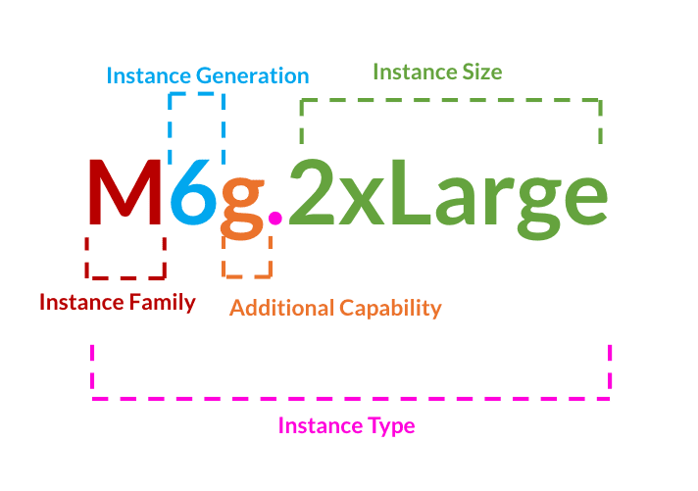
EC2 instance types – Naming convention

Slide 20
EC2 instance types - General Purpose
Great for a diversity of workloads such as web servers or code repositories
Balance between:
Compute
Memory
Networking

Slide 21
EC2 instance types - Compute Optimized
Great for compute-intensive tasks that require high performance processors:
Batch processing workloads
Media transcoding
High performance web servers
High performance computing (HPC)
Scientific modeling & machine learning
Dedicated gaming servers

Slide 22
EC2 instance types - Memory Optimized
Fast performance for workloads that process large data sets in memory
Use cases:
High performance, relational/non-relational databases
Distributed web scale cache stores
In-memory databases optimized for BI (business intelligence)
Applications performing real-time processing of big unstructured data

Slide 23
EC2 instance types - Storage Optimized
Great for storage-intensive tasks that require high, sequential read and write access to large data sets on local storage
Use cases:
High frequency online transaction processing (OLTP) systems
Relational & NoSQL databases
Cache for in-memory databases (for example, Redis)
Data warehousing applications
Distributed file systems

Slide 24
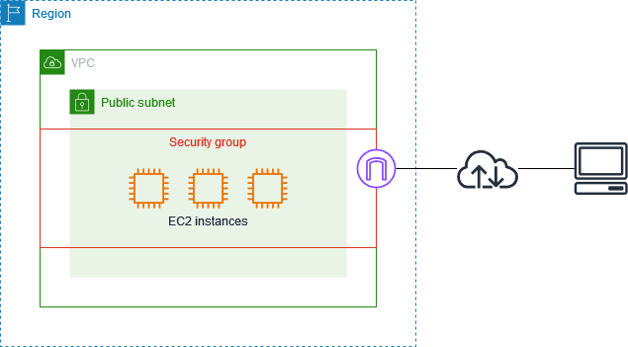
EC2 security groups
A security group acts as a virtual firewall for your EC2 instances to control incoming and outgoing traffic.

Slide 25
Hands-on
Launch the first EC2 instance:
Connect using key pair
Edit security group
Launch with user data
Start/stop/terminate instance

Slide 26
Next step
Service
EC2 environment
EC2 continue
EBS
ASG
ALB
Action
Glossary
Hand-on lab
Test

